Slide 1
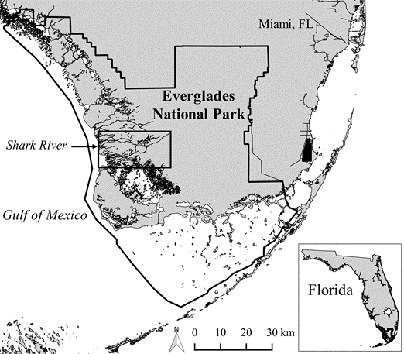
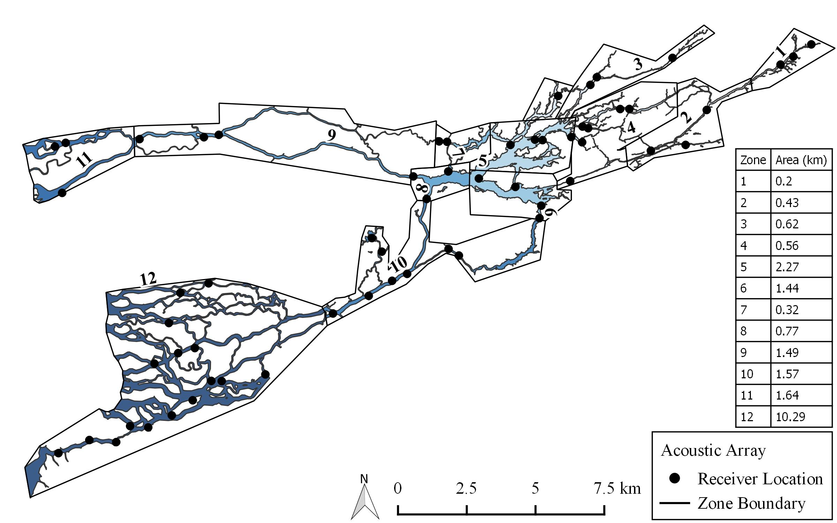
Fig 1.
Rookery Branch
Shark River Zones 1-12
Gulf of Mexico
Tarpon Bay
Florida Bay

Slide 2





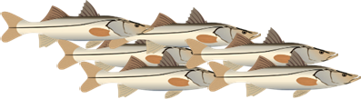
Wet season: High individual variation & heterogenous space use
Dry season: Low individual variation & similar space use
Proportional space use
Downstream
Bay
Upstream
Downstream
Bay
Upstream

Slide 3
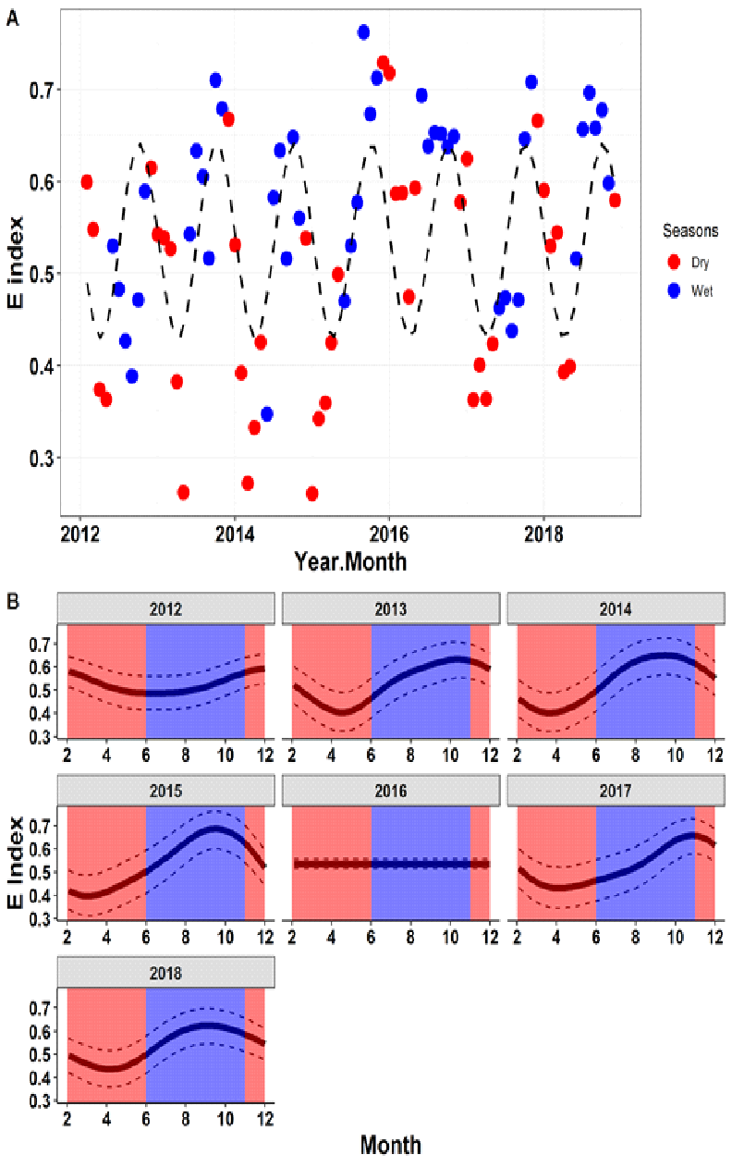


Fig 2
E index: 0-1
1 = individuals use different zones
0 = individuals use proportionally same zones
E box plot for wet vs dry
Analysis run based on new zones,
2012-2016 - dry season is not low for E
2014, 2015
Edf -approaches 1 =linear, 2 = parabolic
Higher value = more nonlinear
2018 borderline
2017- compressed, minimal shift
Blue dots are more bound than red
Dry
Wet
+ Individual variation
Notes:
Does the degree of similarity in space use vary over time (seasons, years)?

Slide 4
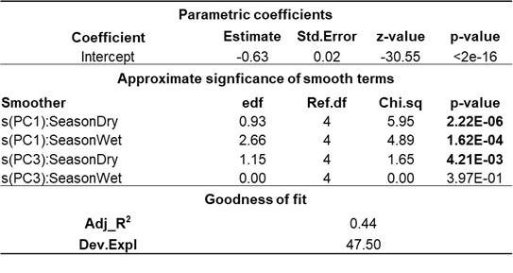
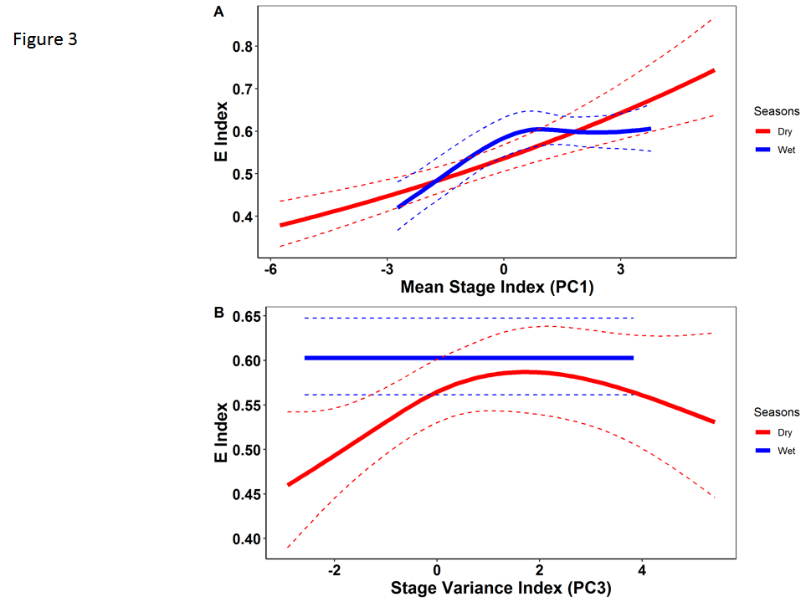

Fig 3
Edf = 1 linear
Edf > 1 parabolic
PC1-PC3dry almost linear
Nonlinear for PC1 wet
Stage matters
Particularly in dry season
Higher range of response
Low stage = similar space use
High sstage = dissimlar space e
Stepwise relationship -
Strongest relationship between to dry season PC1 stage
Most of variaiblity in E is explained by PC1
Secondarily by wet stage
Is interspecific variation in space use related to hydrological conditions?
Yes! Individual variation in space use is most strongly affected by dry season stage
Relationship is positive: as stage increases in dry season, space use becomes more variable = animals use different zones. At low stage, space use is most similar
In wet season, space use varies less. E is also positively related to stage, but levels off – at lower stages, ind variation goes up with stage, but as stage increases space use remains the same.
Variance in stage is less important & only affects dry season Es. Highest levels of ind variation (dispersion in space) at intermediate levels of variance (downriver)

Slide 5
idea is to go from E to niche space
positive correlation with E & trophic niche space
when collected matters for SI data
3 month lag
1. E over time, seasons & years
2. E vs hydrology
3. E vs niche space

Slide 6
to do
1. familiarize yourself with paper & E & e vs hydro
2. look at isotope for all years, table of Snook that have c/n/s in april, may, june, july
https://docs.google.com/spreadsheets/d/1HDde1w_RILLdfaa2W-kCbxJgkqowvOUhM0bHA2Hvdg8/edit#gid=2121721943

Slide 7
Wet season: High individual variation & heterogenous space use
Dry season: Low individual variation & similar space use
Proportional space use
Downstream
Bay
Upstream
Downstream
Bay
Upstream
E in dry season
isotope values for animals in mid, late or June/July
correlation between those across years

Slide 8
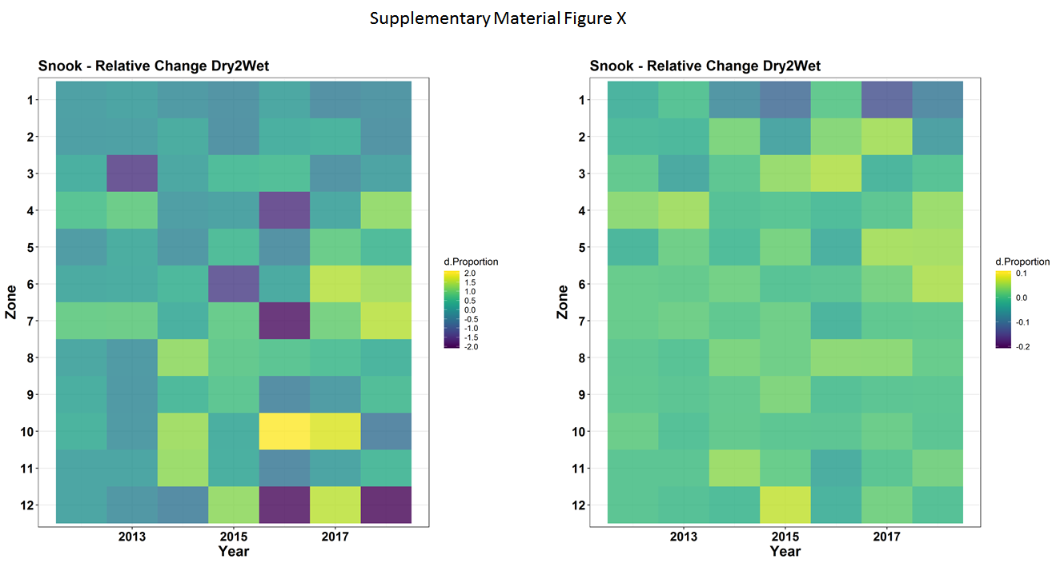
Fig 4
1
2
3
4
5
6
7
8
9
10
11
12
Relative change
+ in wet
Zone
+ in dry
2012 2013 2014 2015 2016 2017 2018

Slide 9
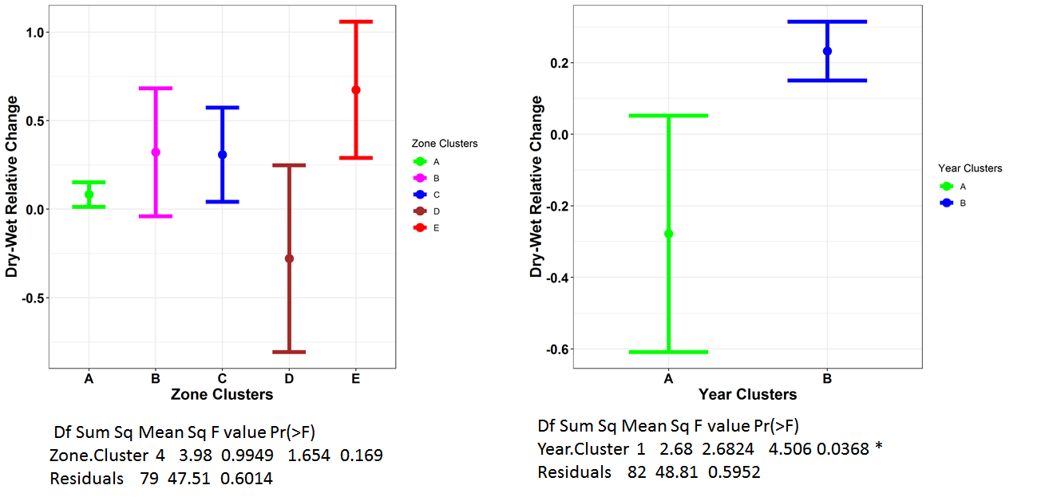
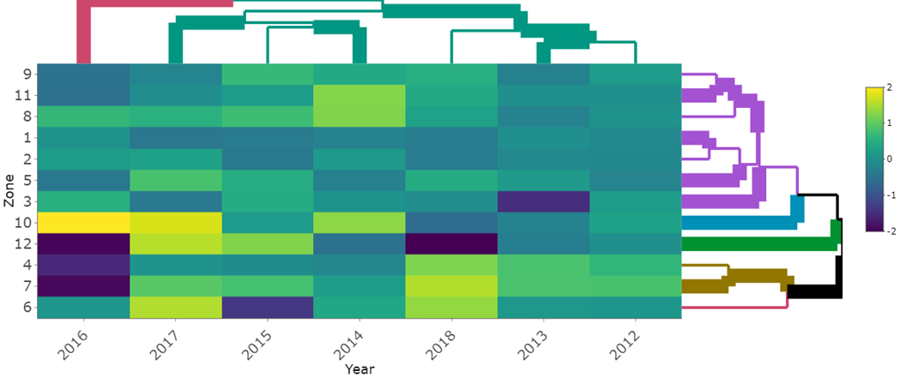
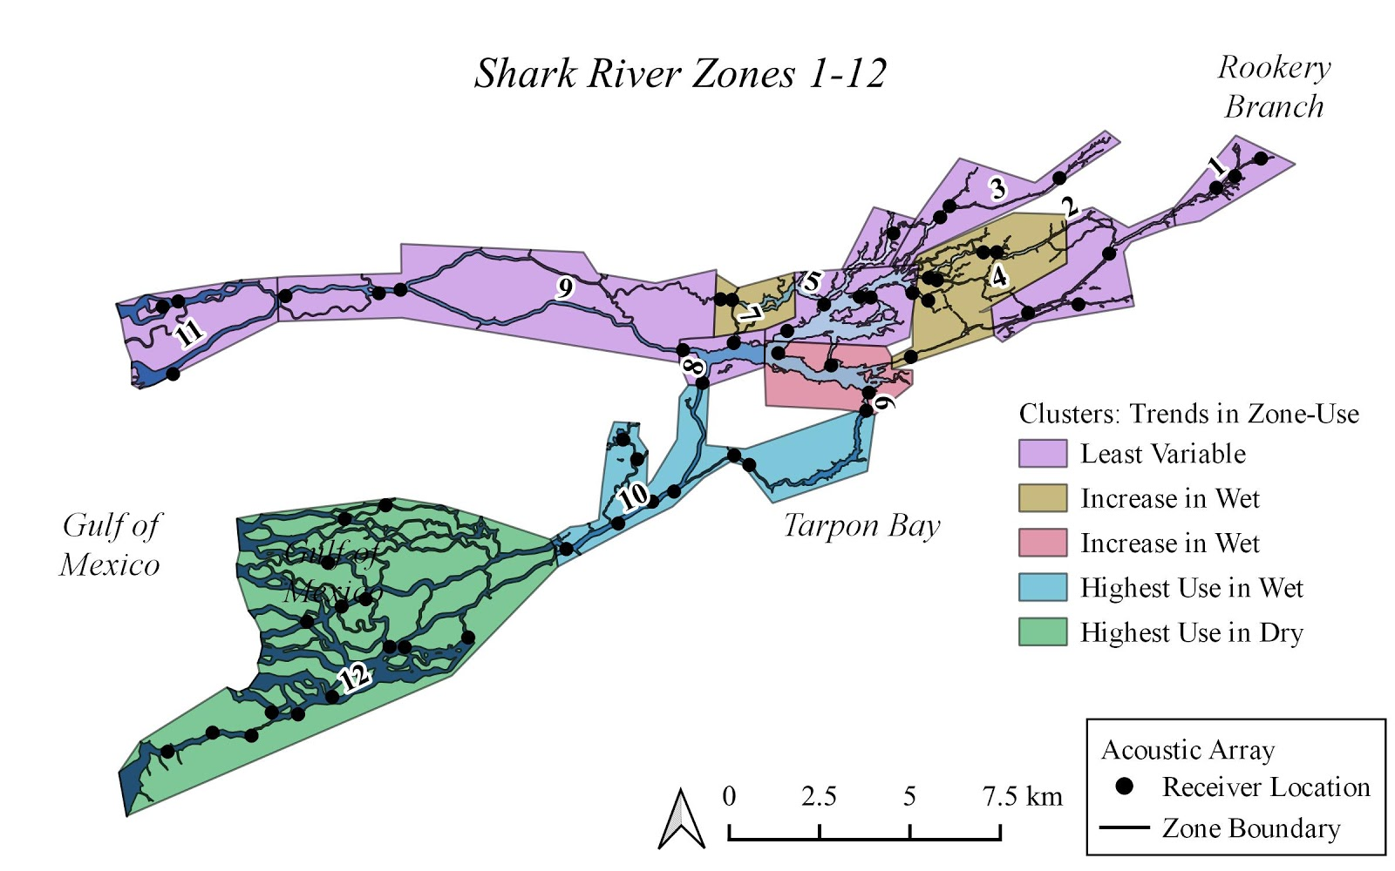
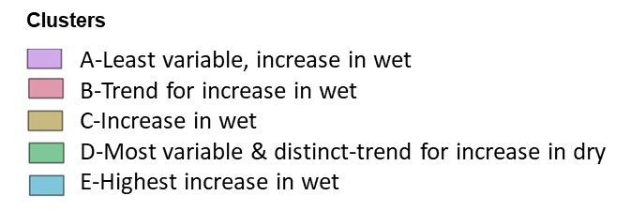
Fig 5
Relative change (log)
A
2016
All other years
+ in wet
+ in dry
A
Year
Zone
E
D
C
B
Year
Clusters
Receiver locations
A-Least variable, increase in wet
B-Trend for increase in wet
C-Increase in wet
D-Most variable & distinct-trend for increase in dry
E-Highest increase in wet
B

Slide 10
App 6
A
Year clusters
B
Zone clusters
2016
All other years

Slide 11
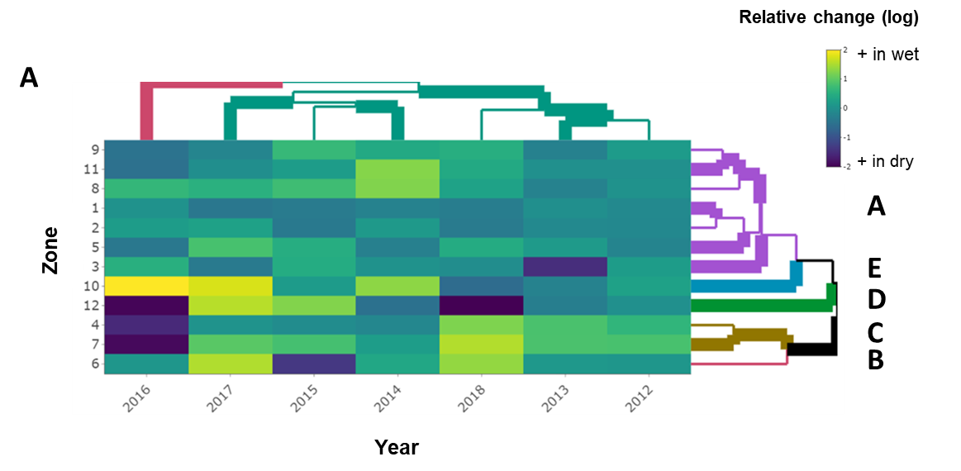
Fig 6
A
Year clusters
B
Zone clusters
2016
All other years

Slide 12
Fig 6
A
Year clusters
B
Zone clusters
All other years
2016

Slide 13
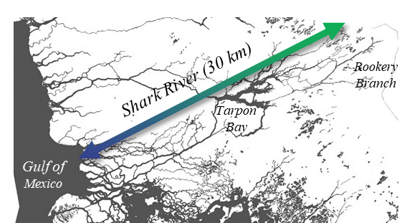
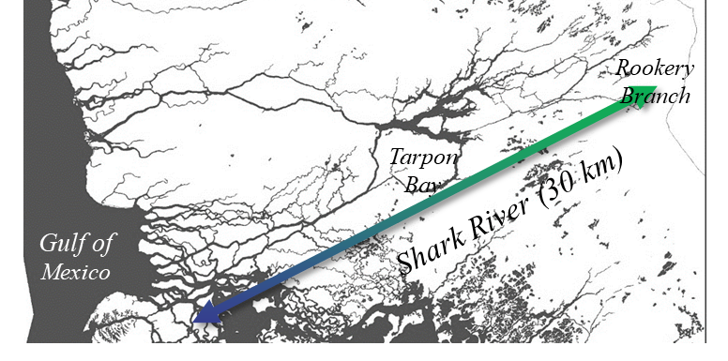
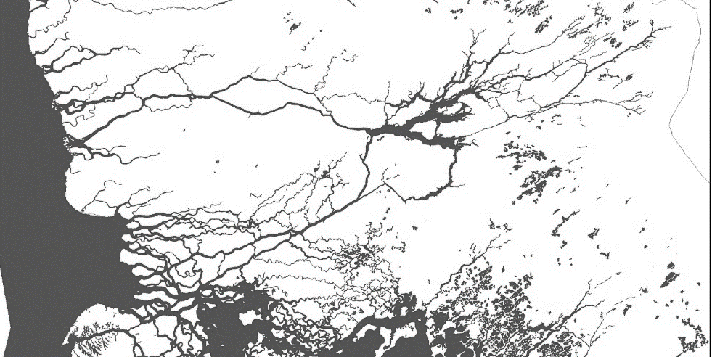
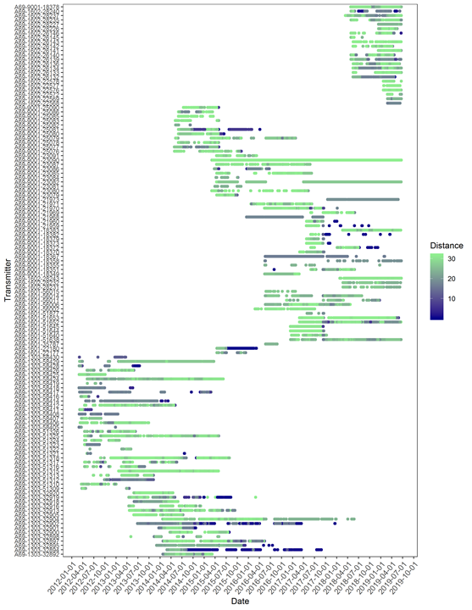
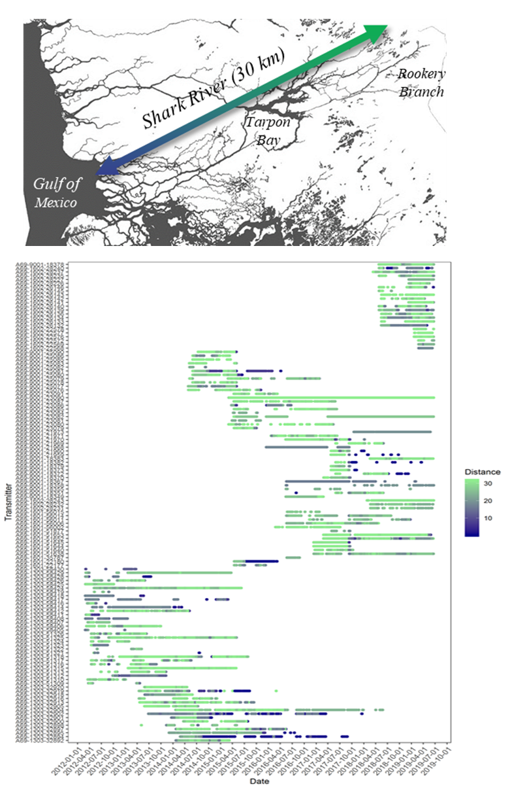
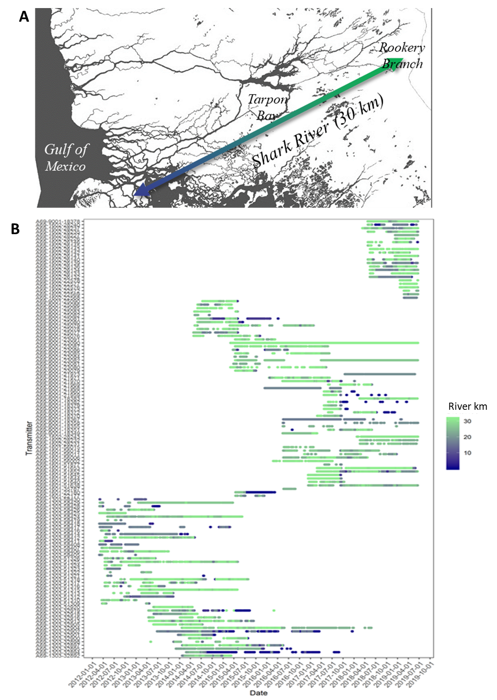
A
Rookery Branch
Tarpon Bay
Shark River (30 km)
Gulf of Mexico
Appendix 1
B
River km

Slide 14
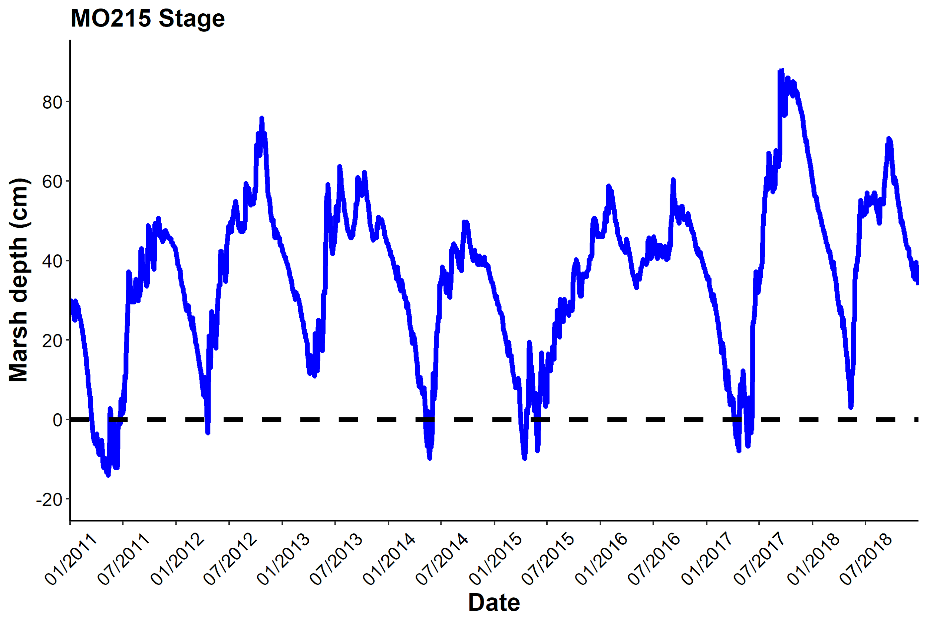
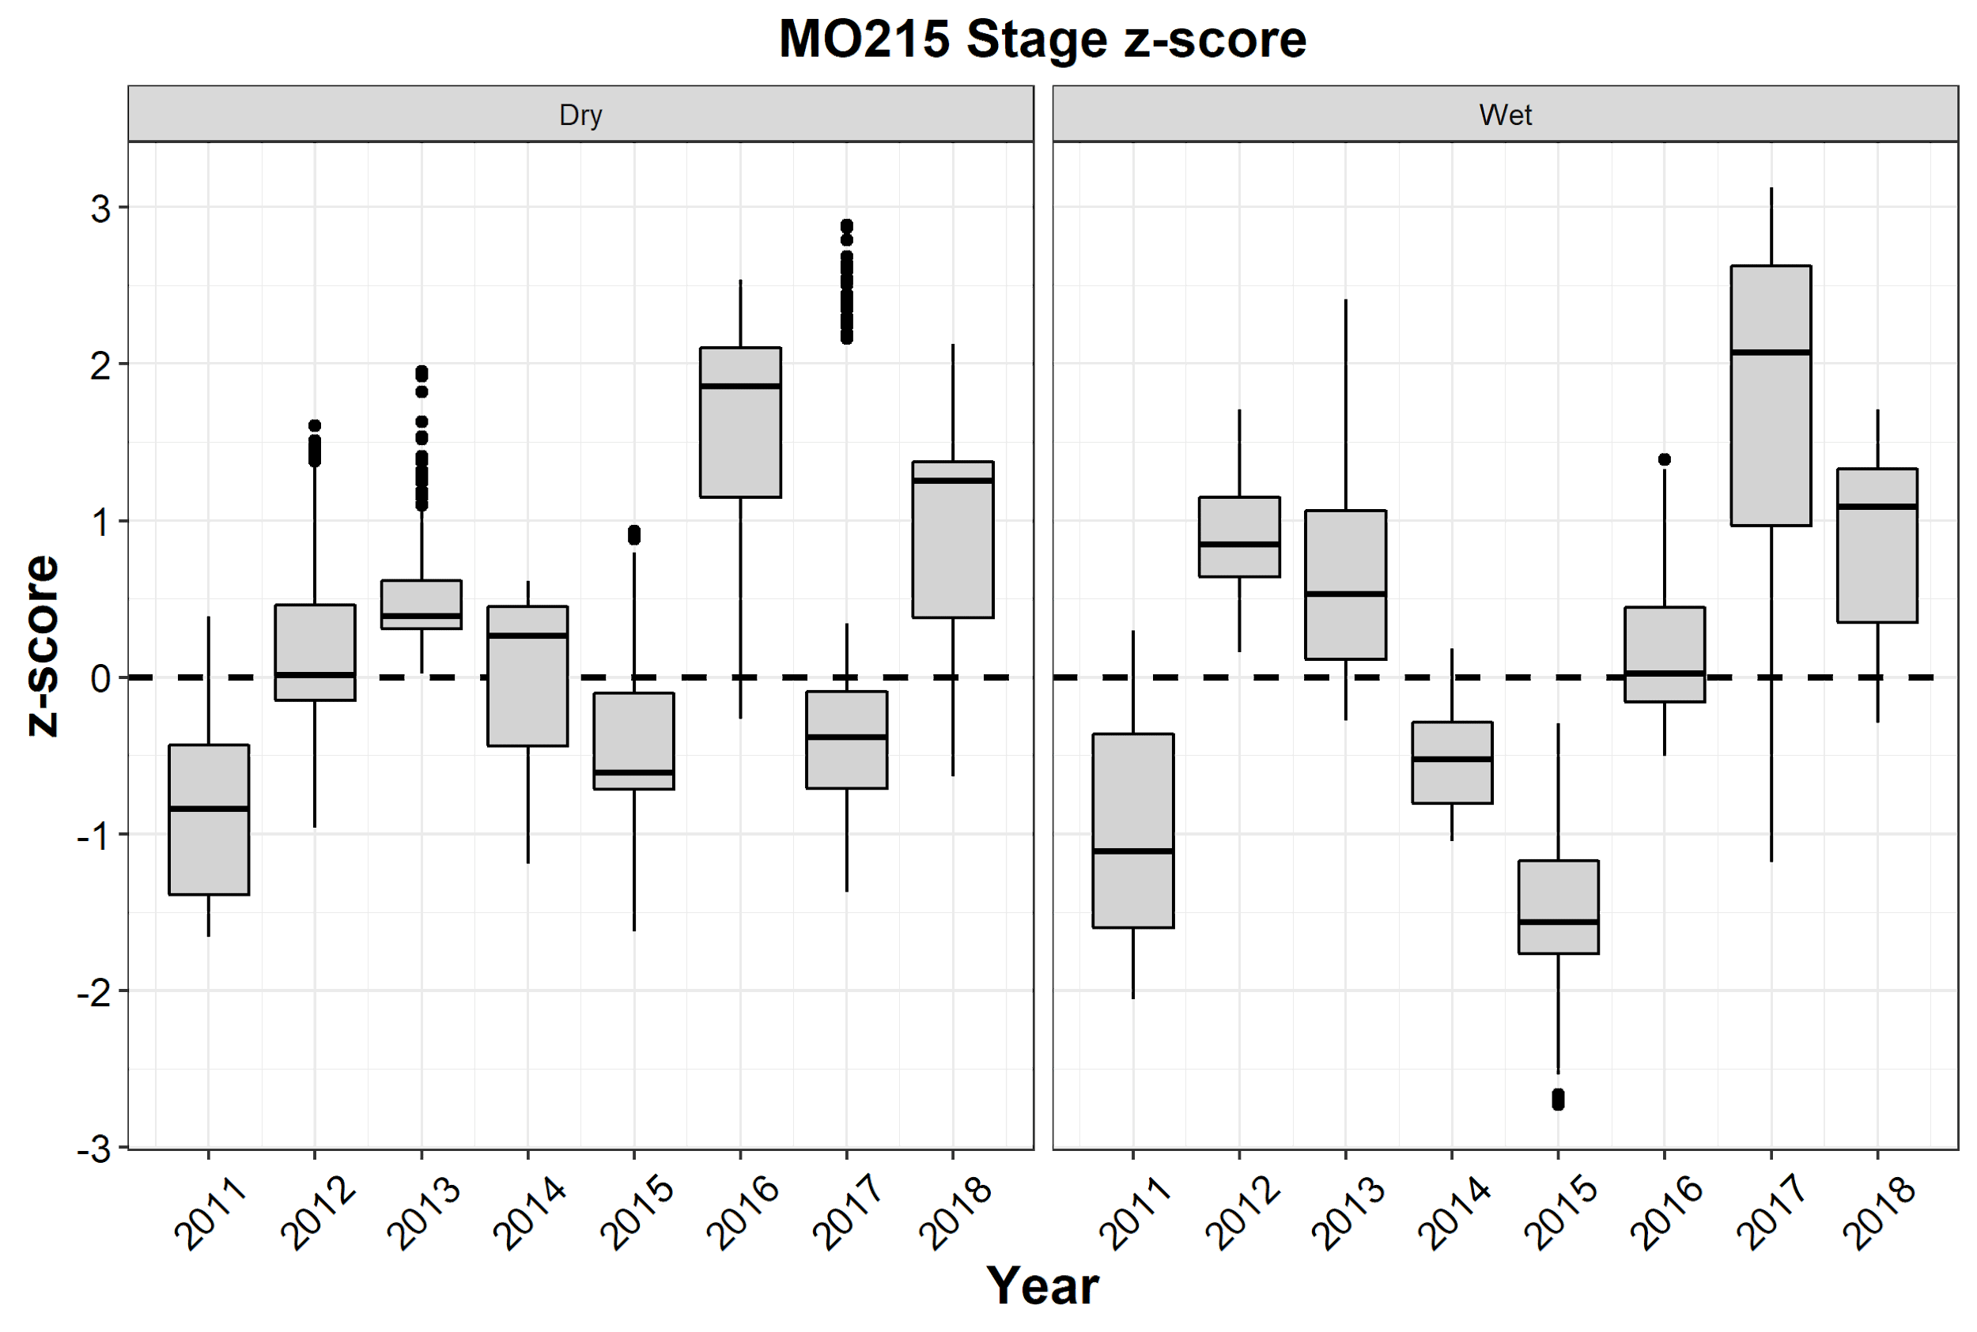
A
Tagging data begins
2017
Hurricane Irma
2011 drought
2015 drought
2016
El Niño
Ungrouped image – may need to send the stage plot to the back to be able to select the shading bars
B

Slide 15
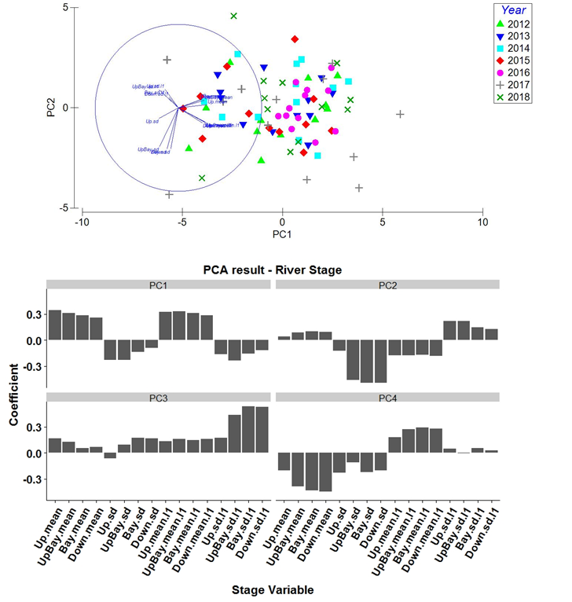
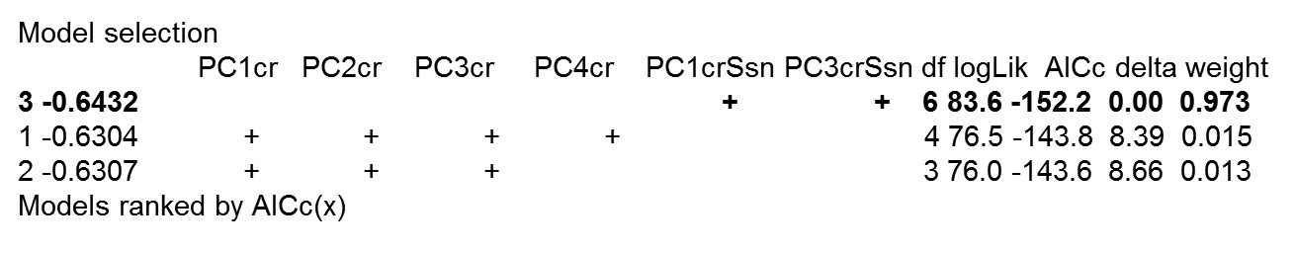
2. Is interspecific variation in space use related to hydrological conditions?
Characterized hydrological conditions across river with a PCA stage across 4 stations in the river & then conducted model selection to select PCs to describe hydrology
16 variables
4 monthly averages
4 Monthly SD
4 Average of previous month
4 SD of previous month
PC1 – mean stages
PC2 - sd of present stage
PC3 -sd of previous month downriver
Best model has PC1 & PC3
Appendix 2. PCA results

Slide 16
Fig 4
A
Relative change
1
2
3
4
5
6
7
8
9
10
11
12
+ in wet
Zone
+ in dry
+ in wet
2012 2013 2014 2015 2016 2017 2018
Year
B
+ in dry
A
Zone
B
B
B
B
Year

Slide 17
Fig 5
A
Year clusters
B
Zone clusters
2016
All other years
C

